Slide 1
Watch-website (a common watch website for all brands)
TEAM MEMBERS:
Arunkarthic P
Pazhani Rajan D
Manikandan N

Slide 2
Problem Statement
The goal is to create a personalized and engaging watch shopping platform that helps users find their perfect timepiece and enhances their overall shopping experience.
It should also provide detailed information about each watch, including specifications, materials
The website should offer a wide range of watches and tailor the product recommendations based on the user's specific interests

Slide 3
Objectives
To provide all details about watches and brands for your view, at One place.
Build a user-friendly and visually appealing watch website interface that enhances the browsing and shopping experience for visitors.
Offer a diverse and well-curated selection of watches catering to the specific interests of watch enthusiasts and collectors.
Getting watches directly from the company without third party retailers.
To make aware of various brands and affordable price product with value for money.

Slide 4
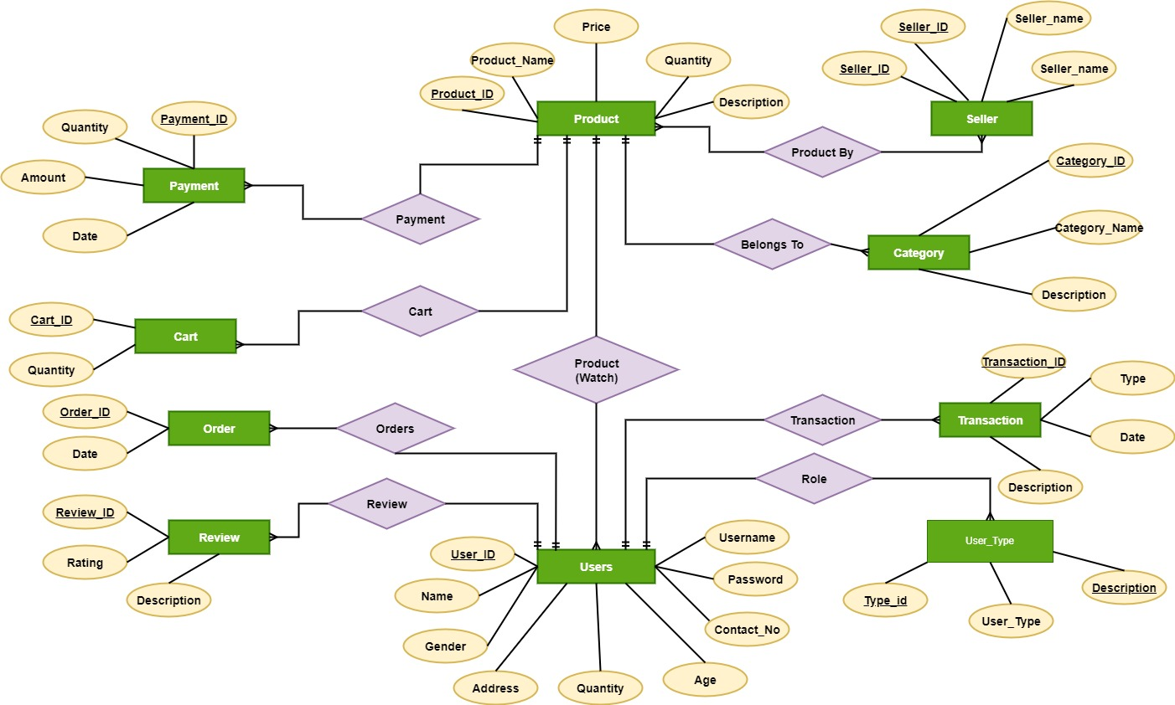
ER-diagram

Slide 5
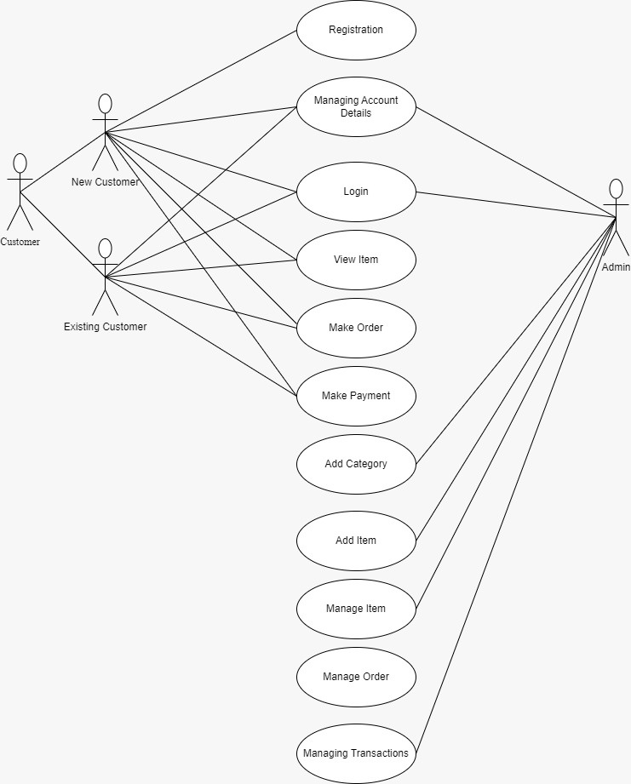
Use case

Slide 6
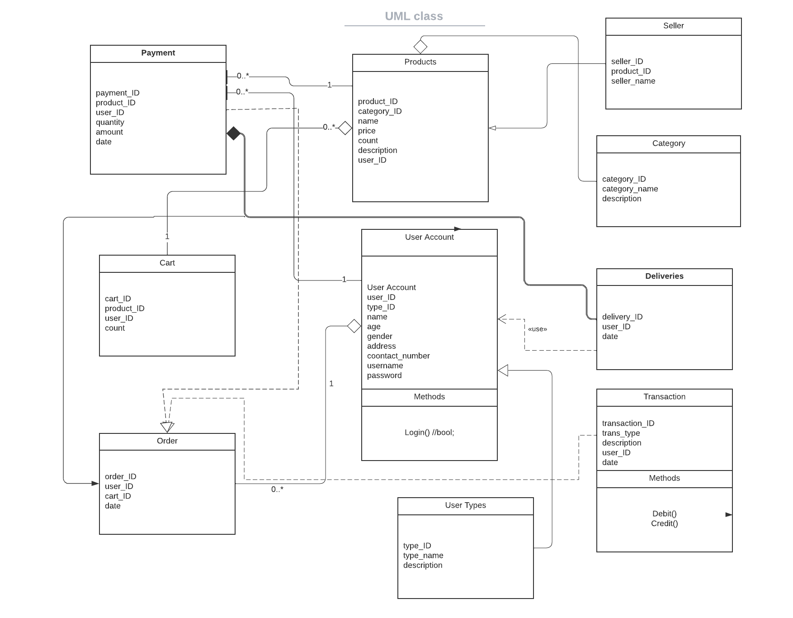
Class diagram

Slide 7
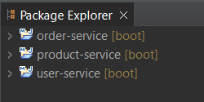
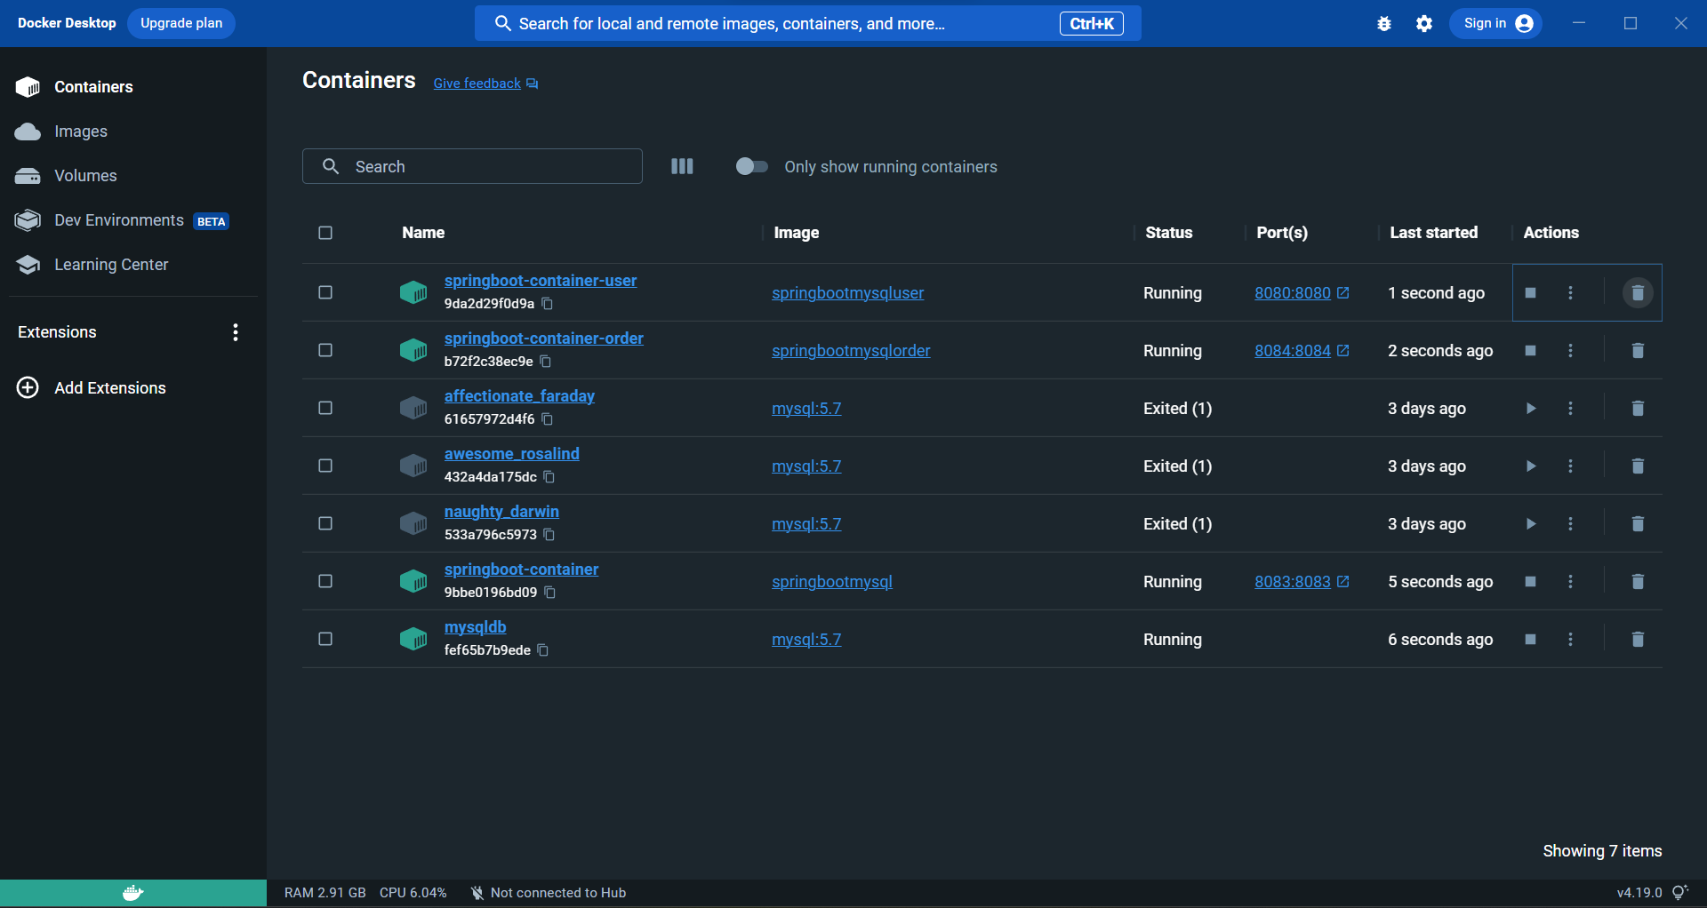
output screenshots
Docker Images
Microservices

Slide 8
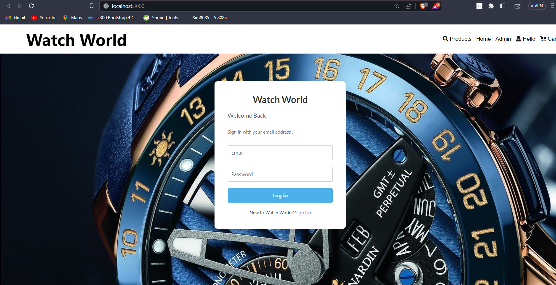
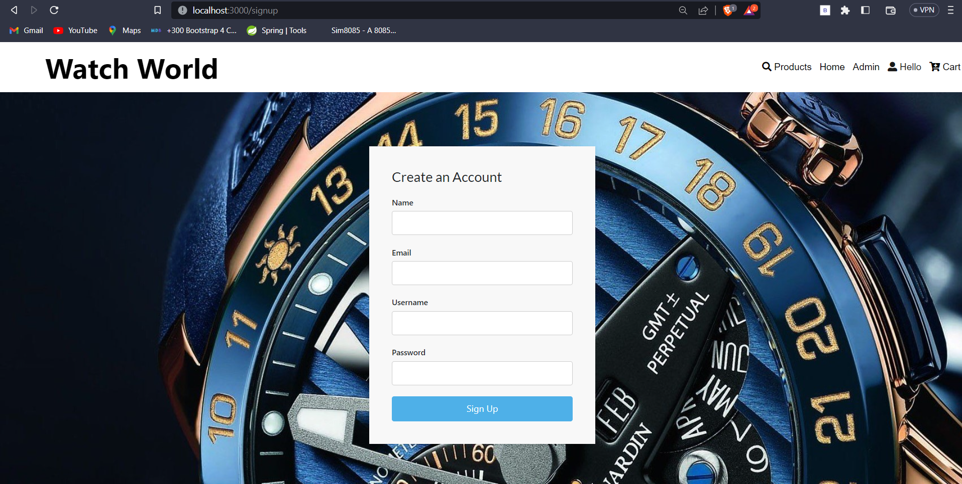
Login Page
Sign Up Page

Slide 9
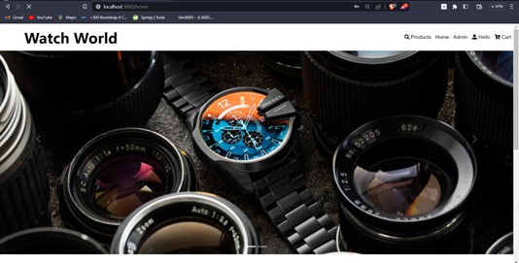
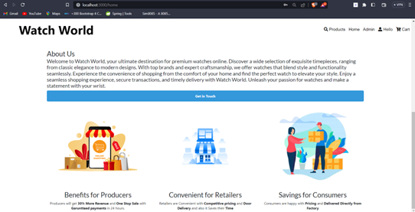
Home Page

Slide 10
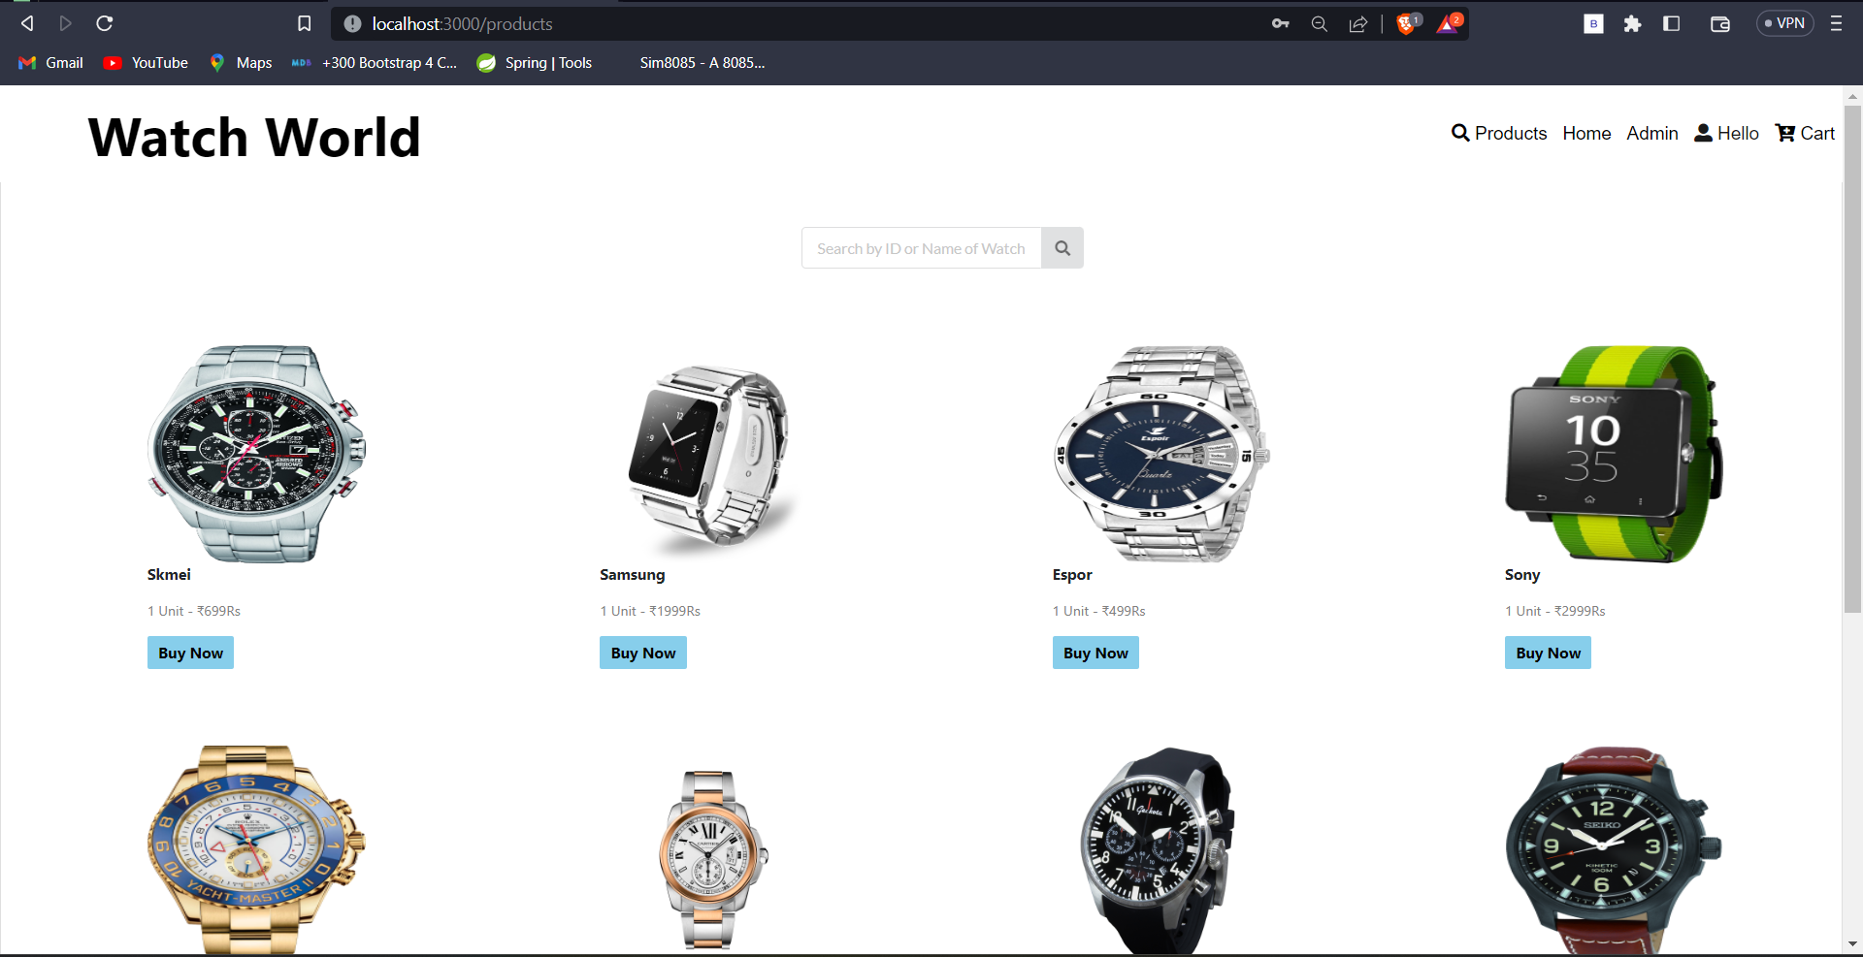
Products

Slide 11
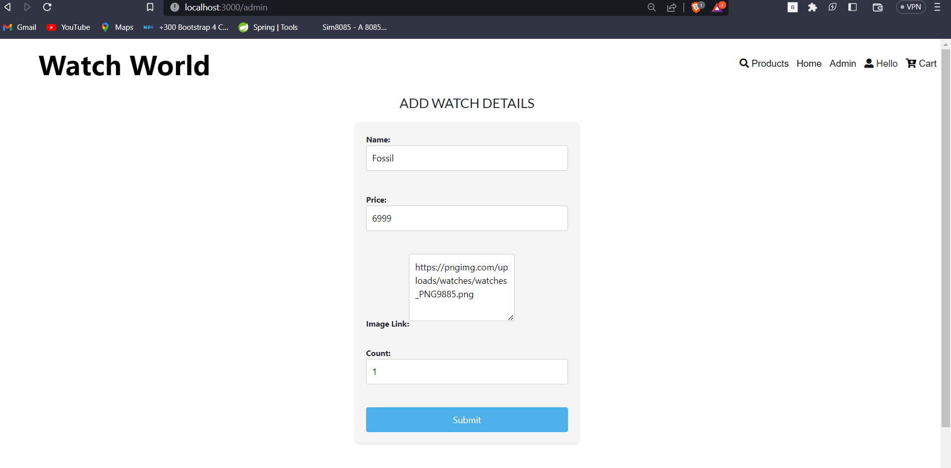
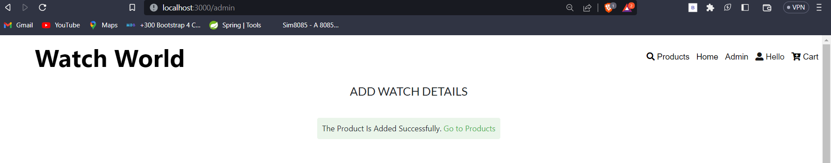
To Add A New Product

Slide 12
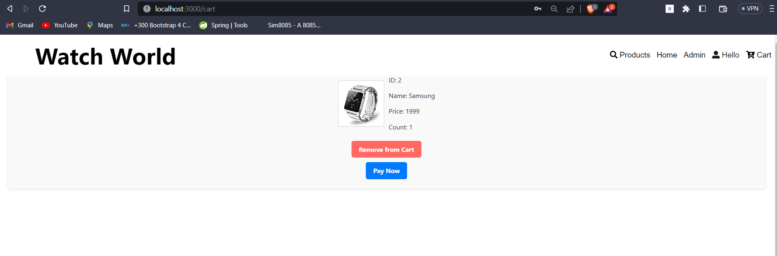
Cart

Slide 13
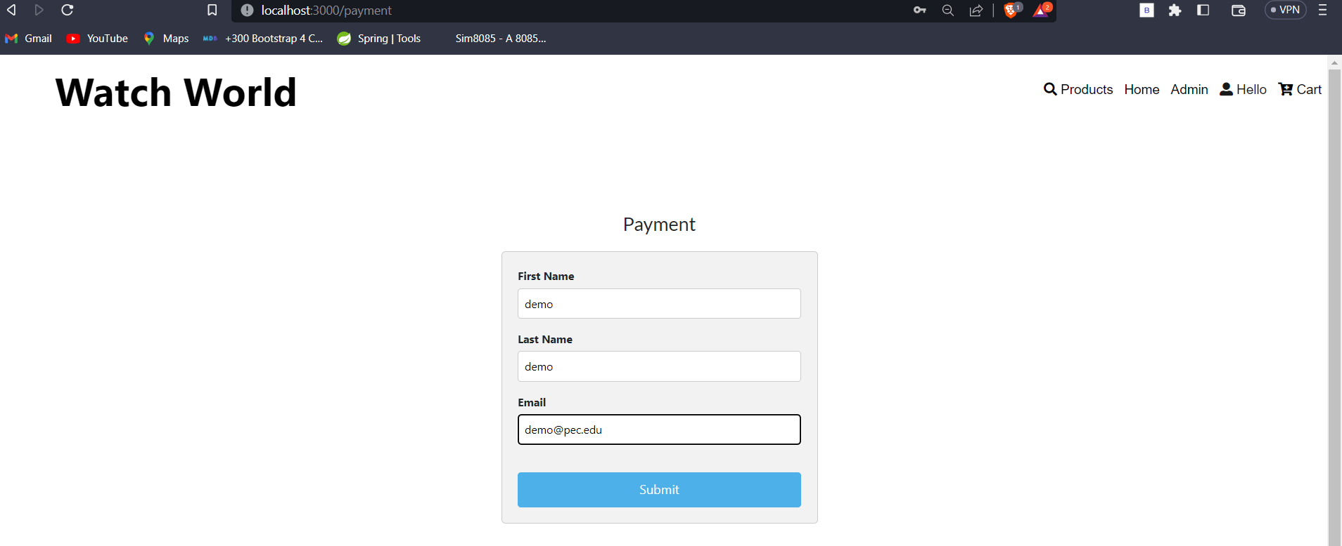
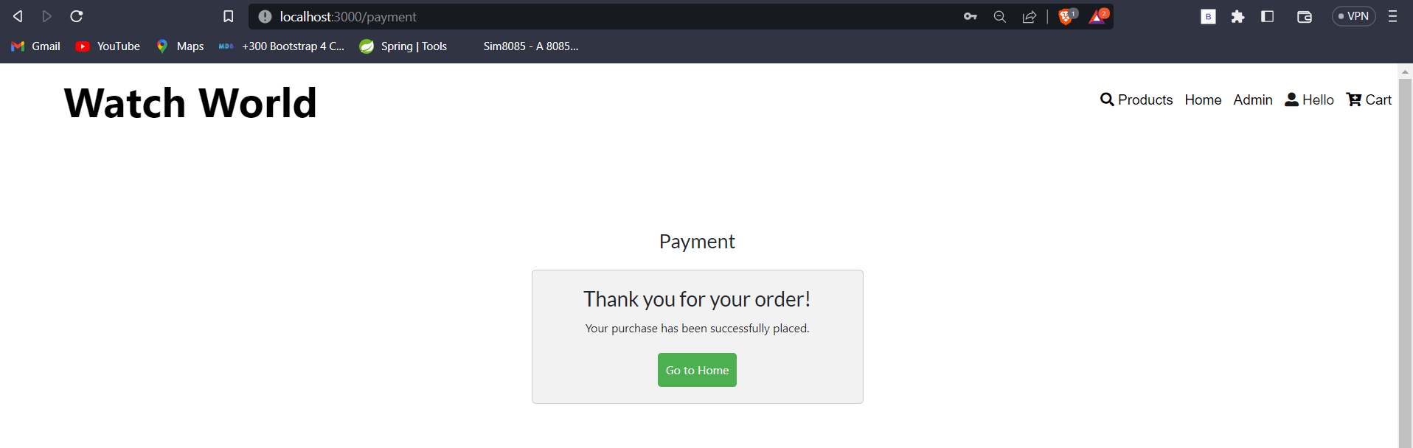
Order

Slide 14
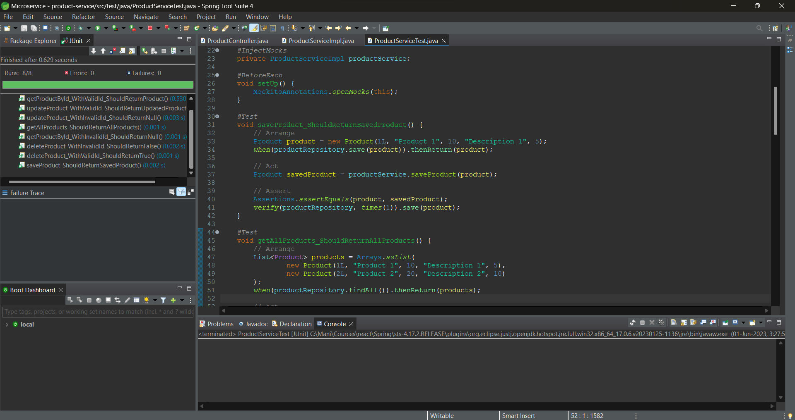
Test Cases sample screenshot

Slide 15
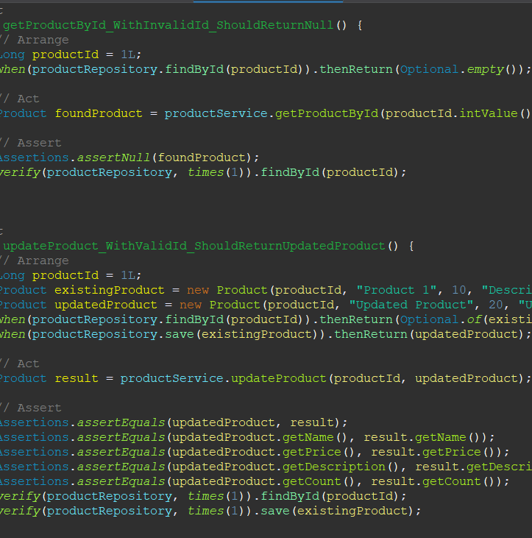
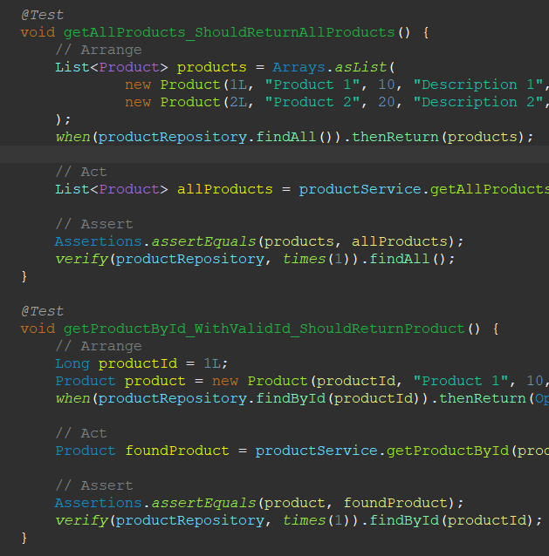

Slide 16
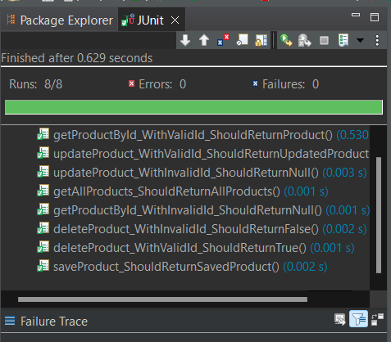
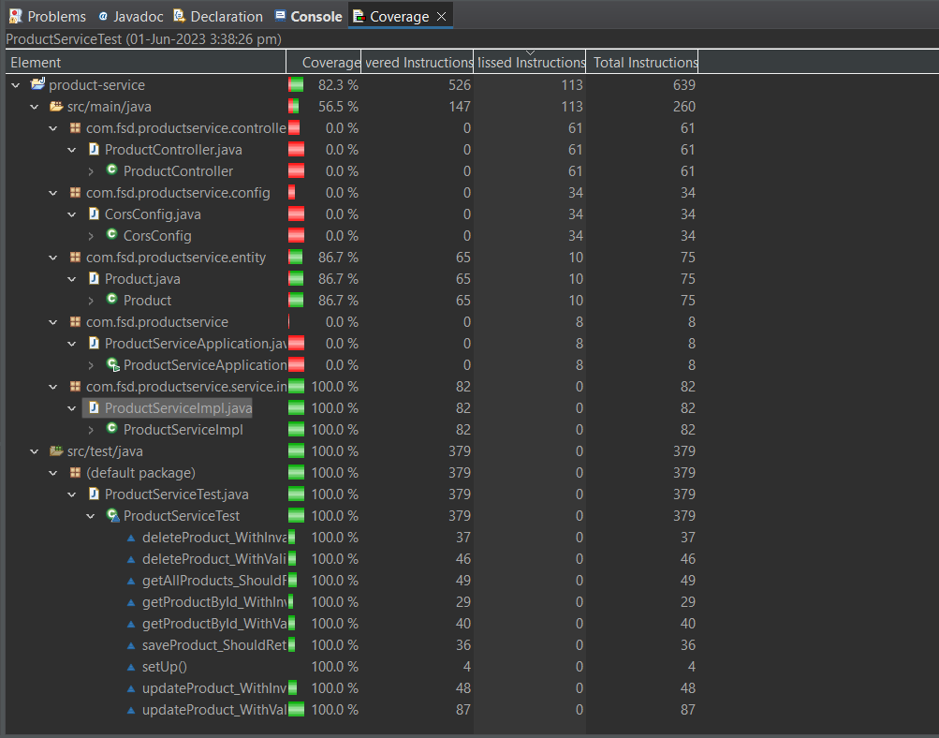
Testing
Coverage

Slide 17
Future Enhancements:
Currently trending watches.
Categorization
ex:-adult,men,women,chid,baby-watches etc....
Comparison between various brands and watches.
Users dashboard.
Additionally, the website should offer interactive features such as virtual try-on options, allowing users to see how a watch would look on their wrist.

